Slide 1
Chapter 2: Project Management

Slide 2
Learning Objectives
Link information systems to business needs
Learn how to create a system request
Understand system feasibility
Learn how to perform a feasibility analysis
Understand how to select a project
Become familiar with work breakdown structure, Gantt charts & network diagrams
Become familiar with use-case driven effort estimation
Learn how to create an interactive project workplan
Learn how to manage the scope, refine estimates and manage the risk of a project
Become familiar with how to staff a project
Learn how the environment and infrastructure workflows interact with the project management workflow

Slide 3
Introduction
Project Management is the process of planning and controlling system development within a specified time at a minimum cost with the right functionality
A project is a set of activities with a specified beginning and end point meant to create a system that brings value to the business
Project Managers monitor and control all tasks and roles that need to be coordinated
Inception phase: generate a system request based on a business need or opportunity
Perform a feasibility analysis; revise the system request
Approve or decline the project
Notes:
Pm === party planner 시간, 비용, (재료) 주어진 시간내에 제대로 해야한다.

Slide 4
Project Identification
Projects are driven by business needs
Identified by business people
Identified by IT people
(better yet) identified jointly by business and IT
The project sponsor believes in the system and wants to see it succeed
Normally this is a business person
Should have the authority to move it forward

Slide 5
Business Value
Tangible Value
Can be quantified and measured directly
Example: 2 percent reduction in operating costs
Intangible Value
We know it will add value & save time, but we may not be able to quantify or measure its benefits
Example: improved customer service
Notes:
회사의 사운이 걸린 프로젝트에 비즈 가치를 따지면 망한다.
IS 시스템에 한정한다.

Slide 6
The System Request
A document that describes the reasons for and the value added from building a new system
Contains 5 elements:
Project sponsor: the primary point of contact for the project
Business need: the reason prompting the project(왜)
Business requirements: what the system will do(무엇을)
Business value: how will the organization benefit from the project(가치)
Special issues: Anything else that should be considered(기타)

Slide 7
Feasibility Analysis
Is this project feasible?
What are the risks?
Can these risks be overcome?
Major components:
Technical feasibility (Can we build it?)
Economic feasibility (Should we build it?)
Organizational feasibility (Will they use it?)

Slide 8
Technical Feasibility
Identify risks in the following areas:
The functional area: Are analysts familiar with this portion of the business?
The technology: Less familiarity generates more risk
Project size: Large projects have more risk
Compatibility: Difficult integration increases the risk

Slide 9
Economic Feasibility (Cost-Benefit Analysis)
Identify the costs and the benefits
Assign values to the costs and benefits
Determine the cash flow
Determine the value using one or more methods:
Net present value (NPV)
Return on investment (ROI)
Break-even point

Slide 10
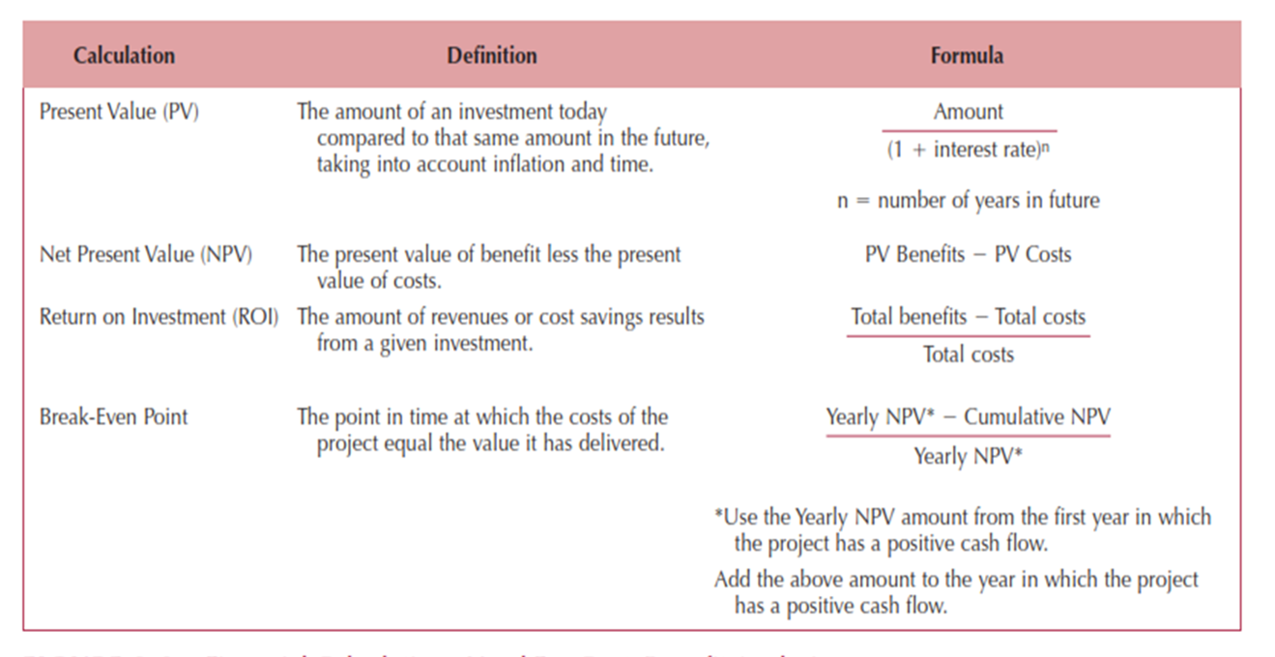
Formulas for Determining Value

Slide 11
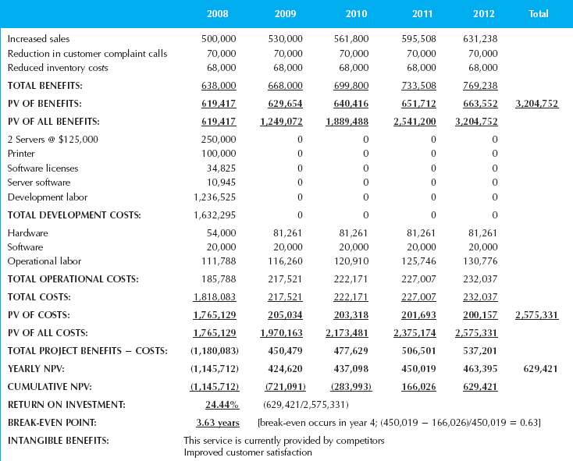
Example Cost-Benefit Analysis

Slide 12
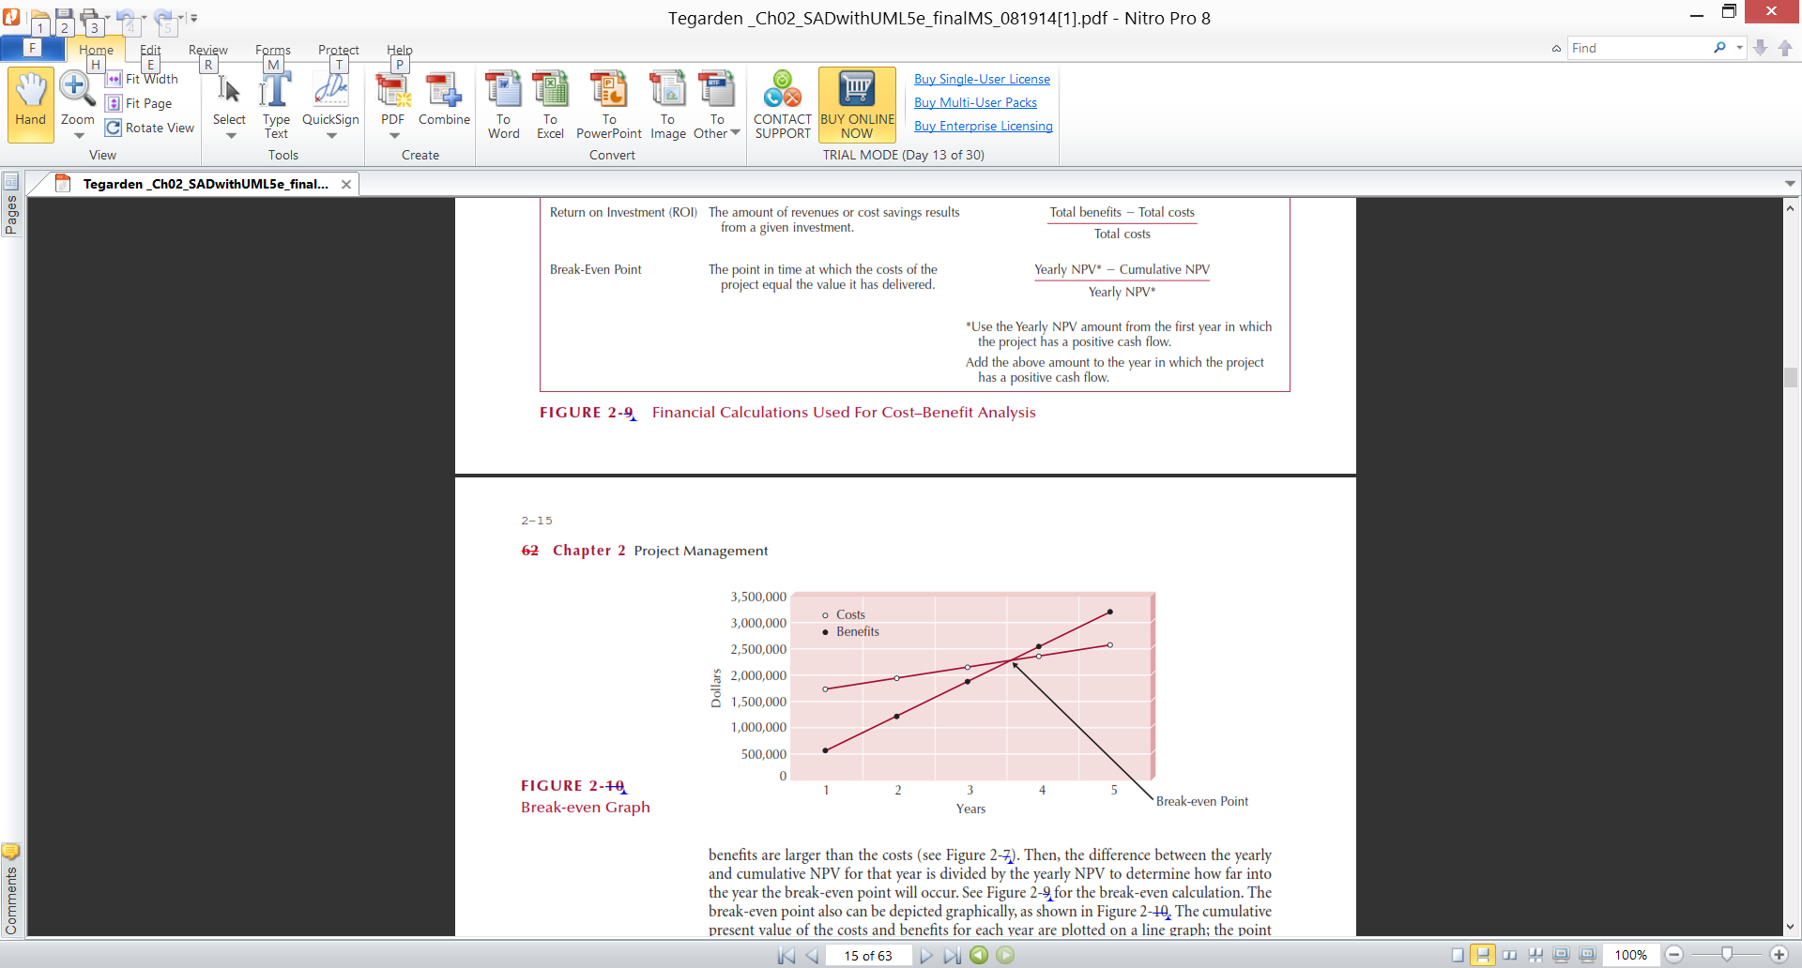
Example Break-Even Point

Slide 13
Organizational Feasibility
Will the users accept the system?
Is the project strategically aligned with the business?
Conduct a stakeholder analysis
Project champion(s)
Organizational management
System users
Others

Slide 14
Project Selection
Projects are approved, declined or delayed based on value added vs. risks
Project portfolio management
Goals:
Maximize cost/benefit ratio
Maintain an optimal mix of projects based on:
Risk
Size, cost & length of time to complete
Purpose, scope & business value
Limited resources require trade-offs
Selected projects enter the project management process

Slide 16





Key Definitions
Project management is the process of planning and controlling the development of a system within a specified timeframe at a minimum cost with the right functionality.
A project manager has the primary responsibility for managing the hundreds of tasks and roles that need to be carefully coordinated.

Slide 17
Four Key Steps in Managing Projects
Identifying project size
Creating and managing the workplan
Staffing the project
Coordinating project activities

Slide 18
IDENTIFYING PROJECT SIZE

Slide 19
Project Manager’s Balancing Act
Project Management involves
making trade-offs…
Project Size
Project Cost
Project Time
Modifying one element
requires adjusting the others

Slide 20
Project Estimation
The process of assigning projected values for time and effort
Sources of estimates
Methodology in use
Actual previous projects
Experienced developers
Estimates begin as a range and become more specific as the project progresses

Slide 21
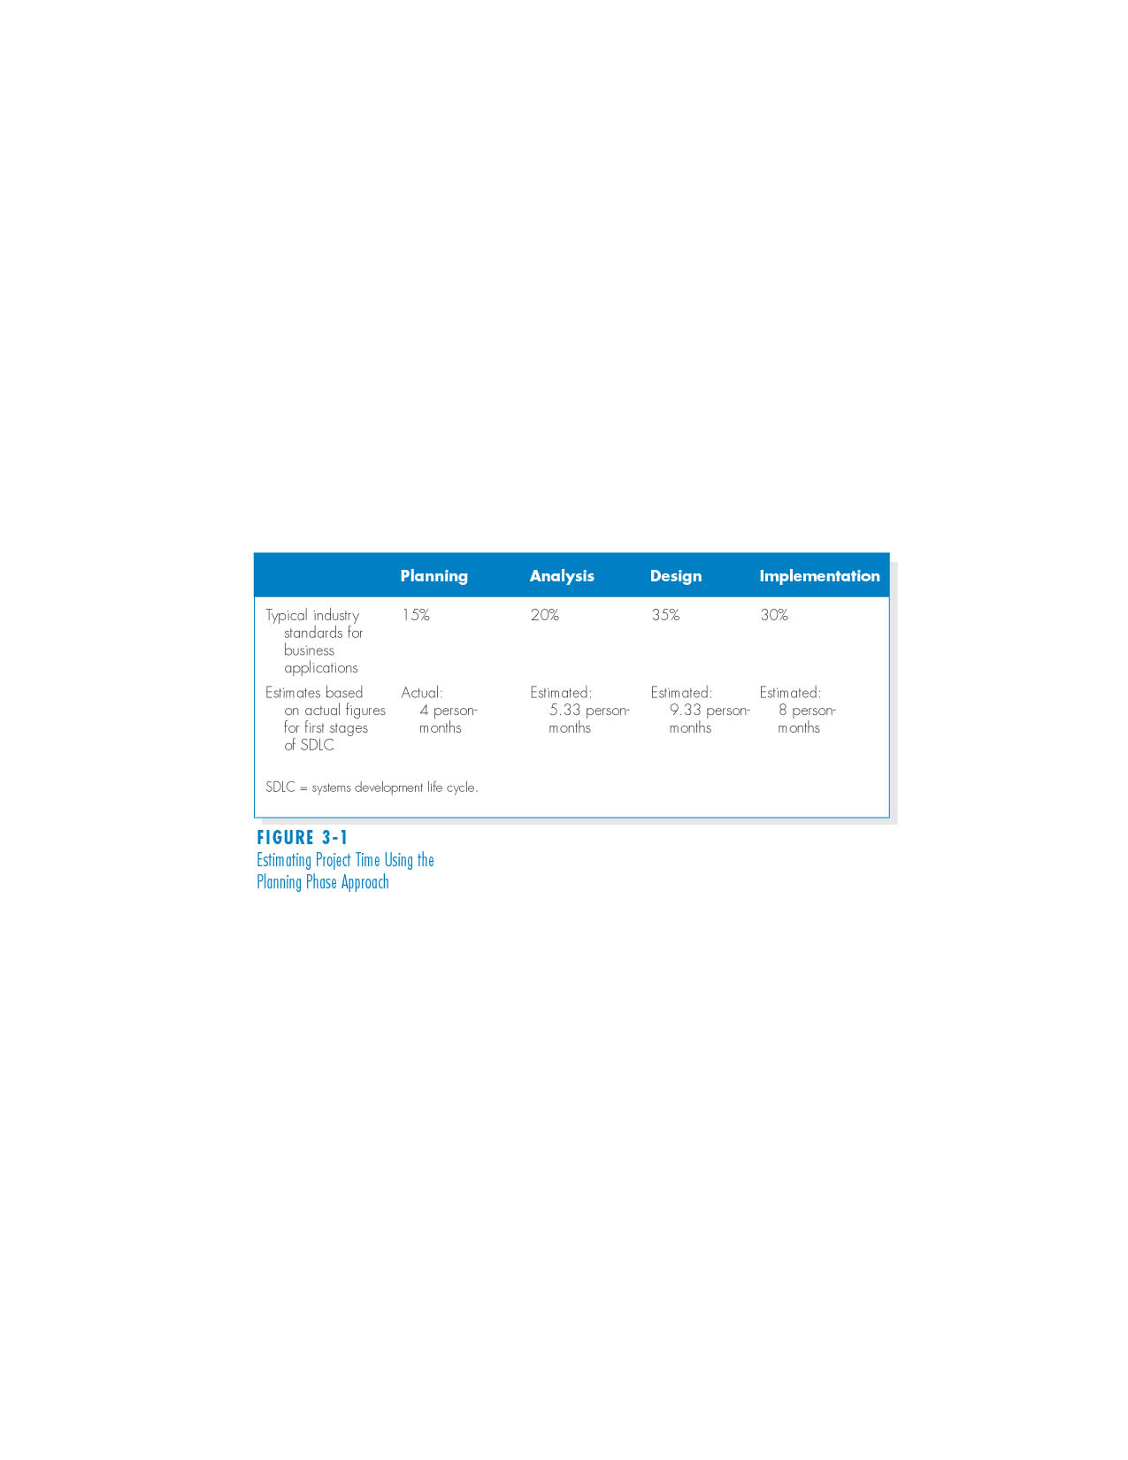
Project Time Using the Planning Phase Approach

Slide 22
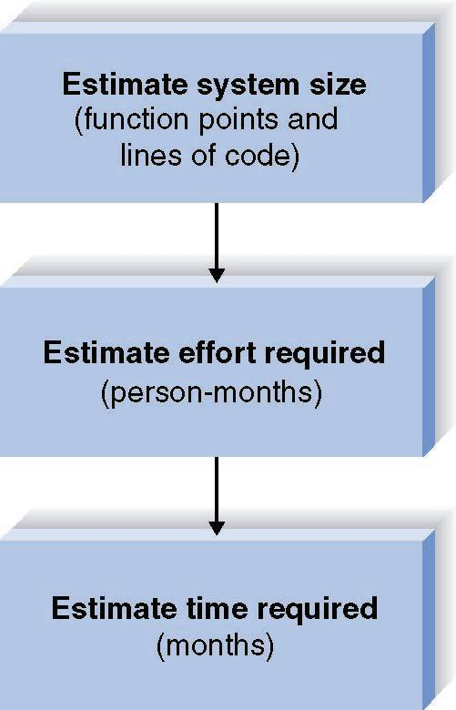
Project Estimation Using the Function Point Approach

Slide 23
Function Points ?
A concept developed in 1979 by Allen Albrecht of IBM
A measure of program size based on system’s number and complexity
Inputs (eg. date entry screen)
Outputs (eg. reports)
Queries (eg. database queries)
Files
Program Interfaces

Slide 24
Function Point Estimation Worksheet Step One – Estimate System Size (System Components)
 |  | Complexity
Description | Total Number | Low | Medium | High | Total
Inputs | 6 | 3 x 3 | 2 x 4 | 1 x 6 | 23
Outputs | 19 | 4 x 4 | 10 x 5 | 5 x 7 | 101
Queries | 15 | 0 x 7 | 15 x 10 | 0 x 15 | 39
Files | 15 | 0 x 7 | 15 x 10 | 0 x 15 | 150
Program Interfaces | 3 | 1 x 5 | 0 x 7 | 2 x 10 | 25
Total Unadjusted Function Points (TUFF): |  |  |  |  | 338

Slide 25
Function Point Estimation Worksheet Step One – Estimate System Size (Overall System - Example)
( 0 = no effort on processing complexity; 3 = great effect on processing complexity)
Data Communications 3 Heavy use configuration 0 Transaction rate 0
End-user efficiency 0 Complex processing 0 Installation ease 0 Multiple sites 0 Performance 0 Distributed functions 2 Online data entry 2 Reusability 1 Operational ease 0
Extensibility 0 Total Processing Complexity (PC): 8

Slide 26
Function Point Estimation Adjusting the Function Points
Processing Complexity (PC): __8_____
(From Step 1)
Adjusted Processing
Complexity (APC) = 0.65 + (0.01 * _8_ ) = 0.73
Total Adjusted
Function Points (TAFP): 0.73 * 338 =
(TUFP -- From Step 1)
247

Slide 27
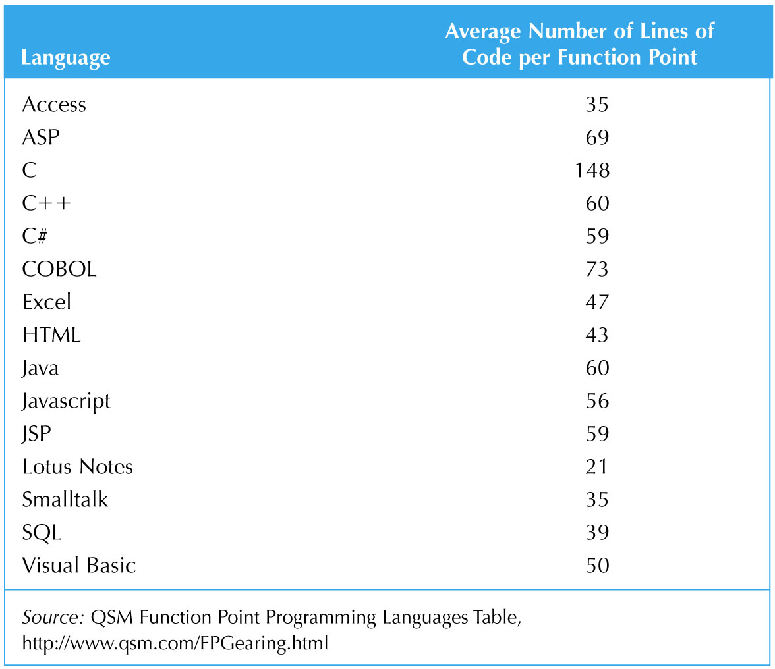
Converting Function Points to Lines of Code

Slide 28
Function Point Estimation Step Two – Estimate Effort Required
Function of size and production rate
COCOMO model
(Effort in = 1.4 * thousands-of-lines-of-code
Person Months)
Example:
If LOC = 10000 Then...
Effort = (1.4 * 10) = 14 Person Months

Slide 29
Function Point Estimation Step Three - Schedule Time
Rule of thumb for estimation
Schedule Time (months) =
3.0 * person-months^{1/3} (1/3 is the exponent)
Examples)
Schedule Time (14) = 약 7 months
Schedule Time(37.42) = 약 10 months

Slide 30
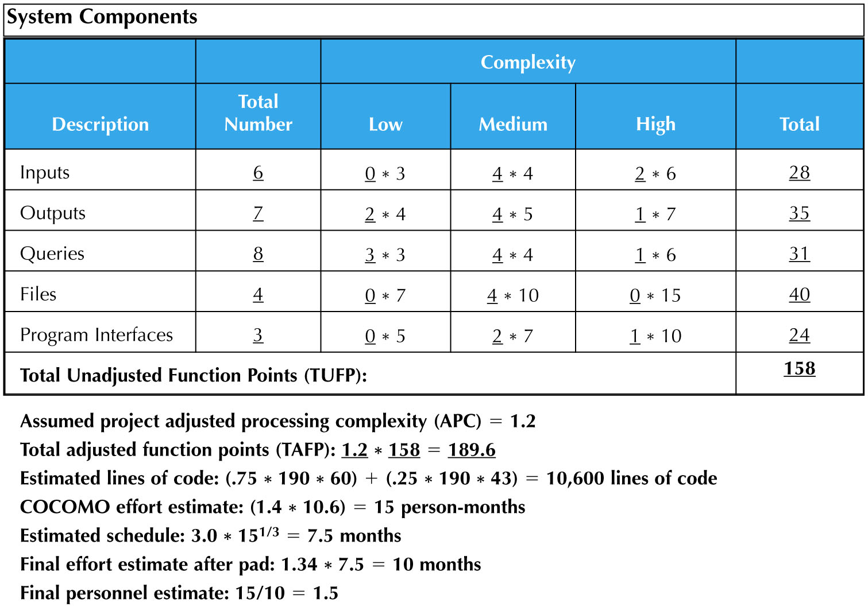
Estimation Example

Slide 31
Project Effort Estimation
Estimation involves trade-offs between functionality, time and cost
It is the process of assigning projected values for time and effort
Most accurate estimates come from experience
Use-case point method; based on:
Technical complexity factors (13)
Environmental factors (8)

Slide 32
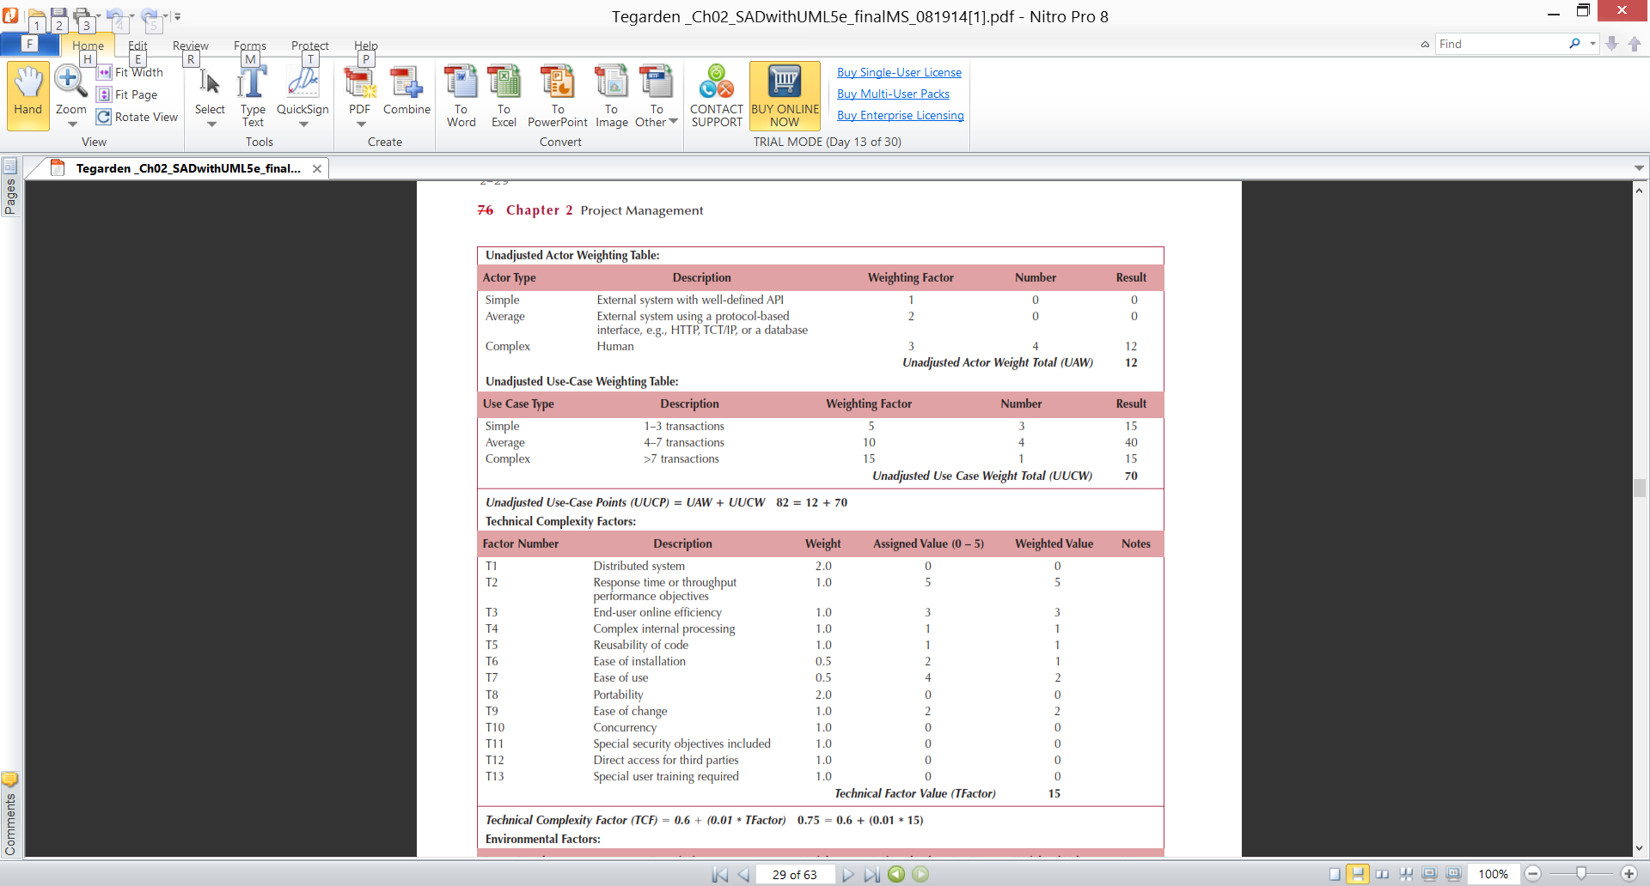
Use-case Estimation Example
Actors & Use-cases:

Slide 33
Use-case Estimation Example
Technical complexity factors:

Slide 34
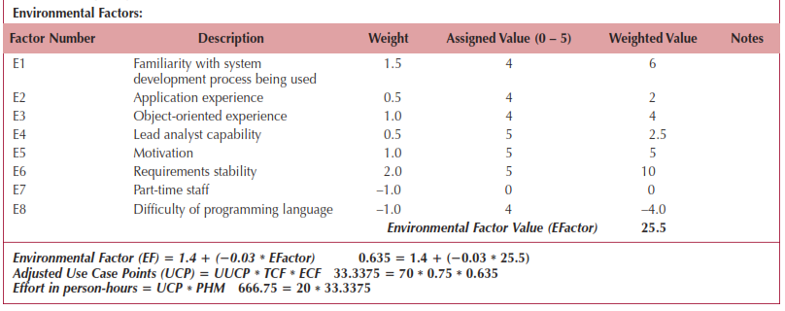
Use-case Estimation Example
Environmental factors & final estimate:

Slide 35
CREATING AND MANAGING THE WORK PLAN

Slide 36
Identifying Tasks
Methodology
Using standard list of tasks
Top-down approach
Identify highest level tasks
Break them into increasingly smaller units
Organize into work breakdown structure

Slide 37
Project Workplan
List of all tasks in the work breakdown structure, plus
Task name
Duration of task
Current task status
Task dependencies
Milestone (dates)

Slide 38
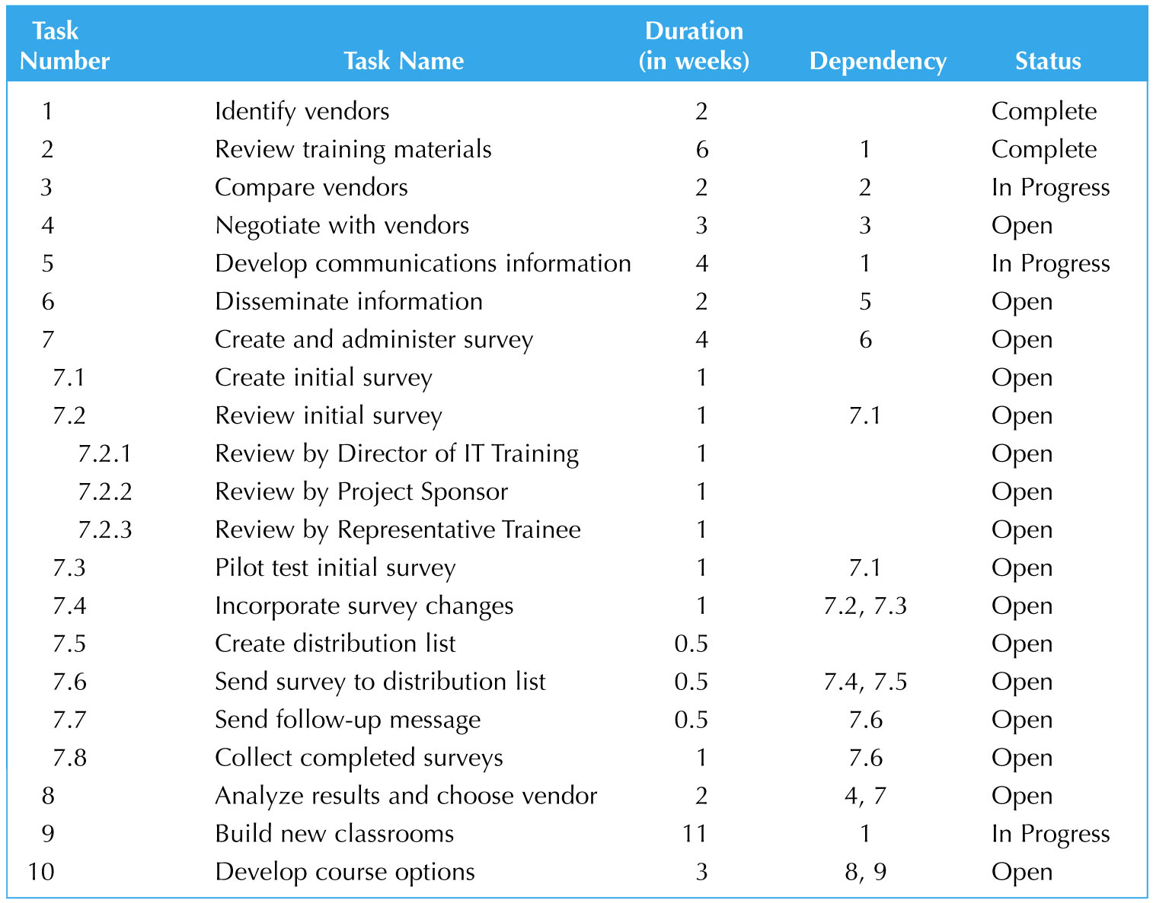
A Work Breakdown Structure

Slide 39
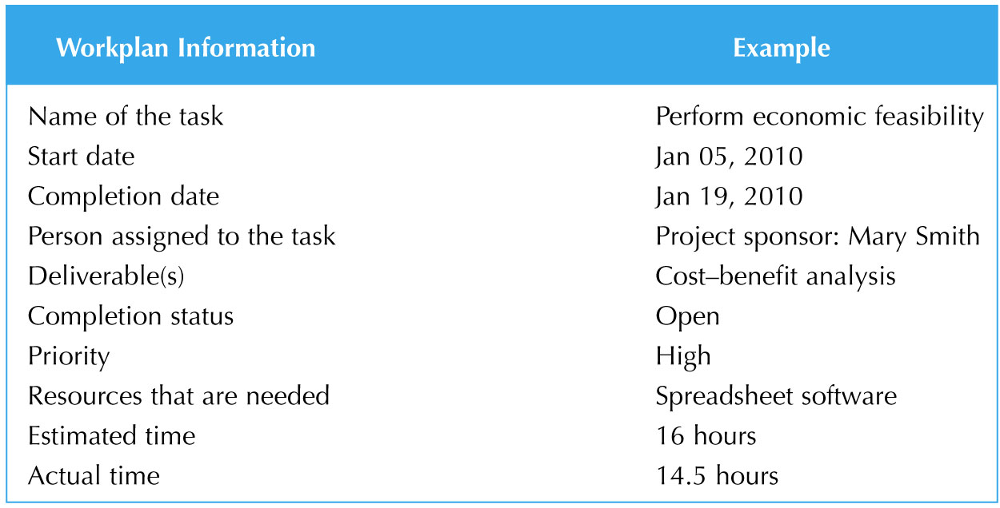
Workplan Information (example)

Slide 40
Tracking Project Tasks
Gantt Chart
Bar chart format
Useful to monitor project status at any point in time
PERT Chart
Flowchart format
Illustrate task dependencies and critical path

Slide 41
Tracking Tasks Using Gantt Chart
Task Week
2 3 4 5 6 7 8 9 10 11 12 13

Slide 42
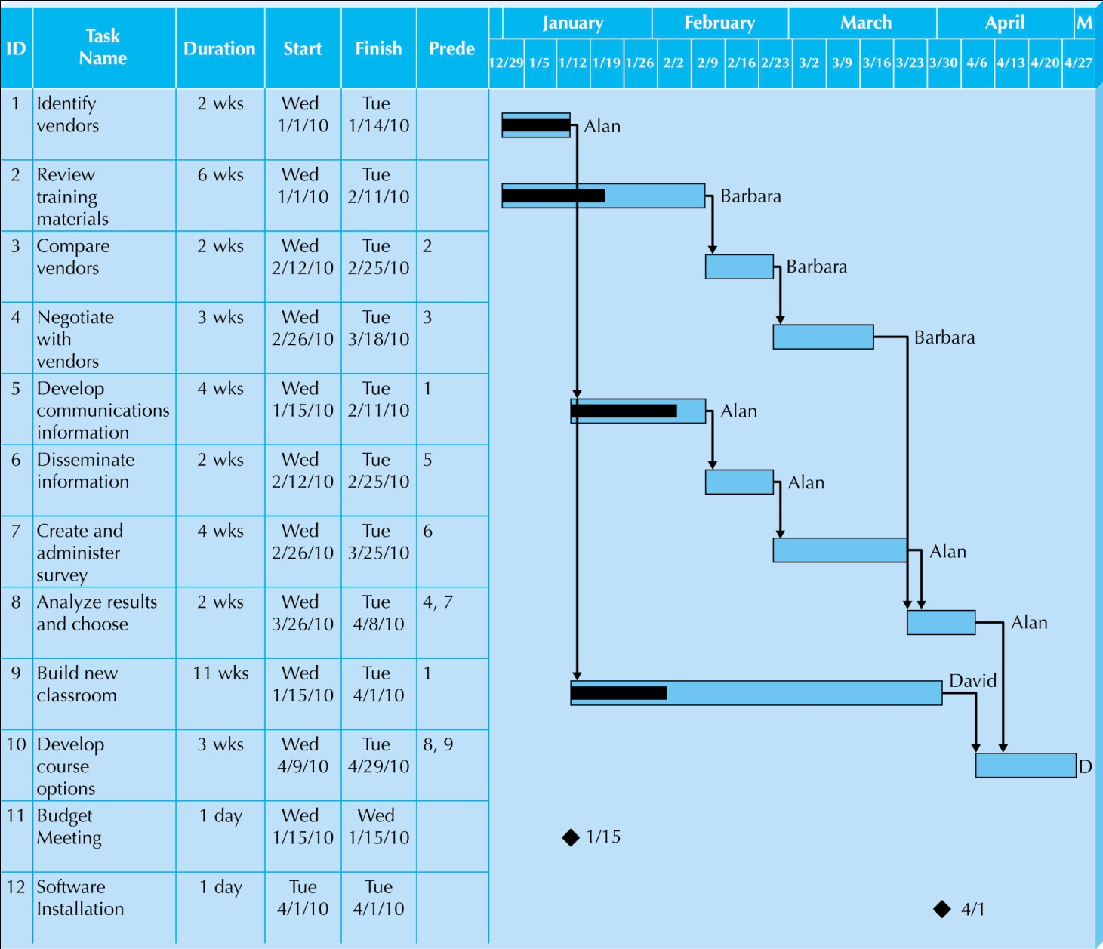
Gantt Chart Example 2

Slide 43
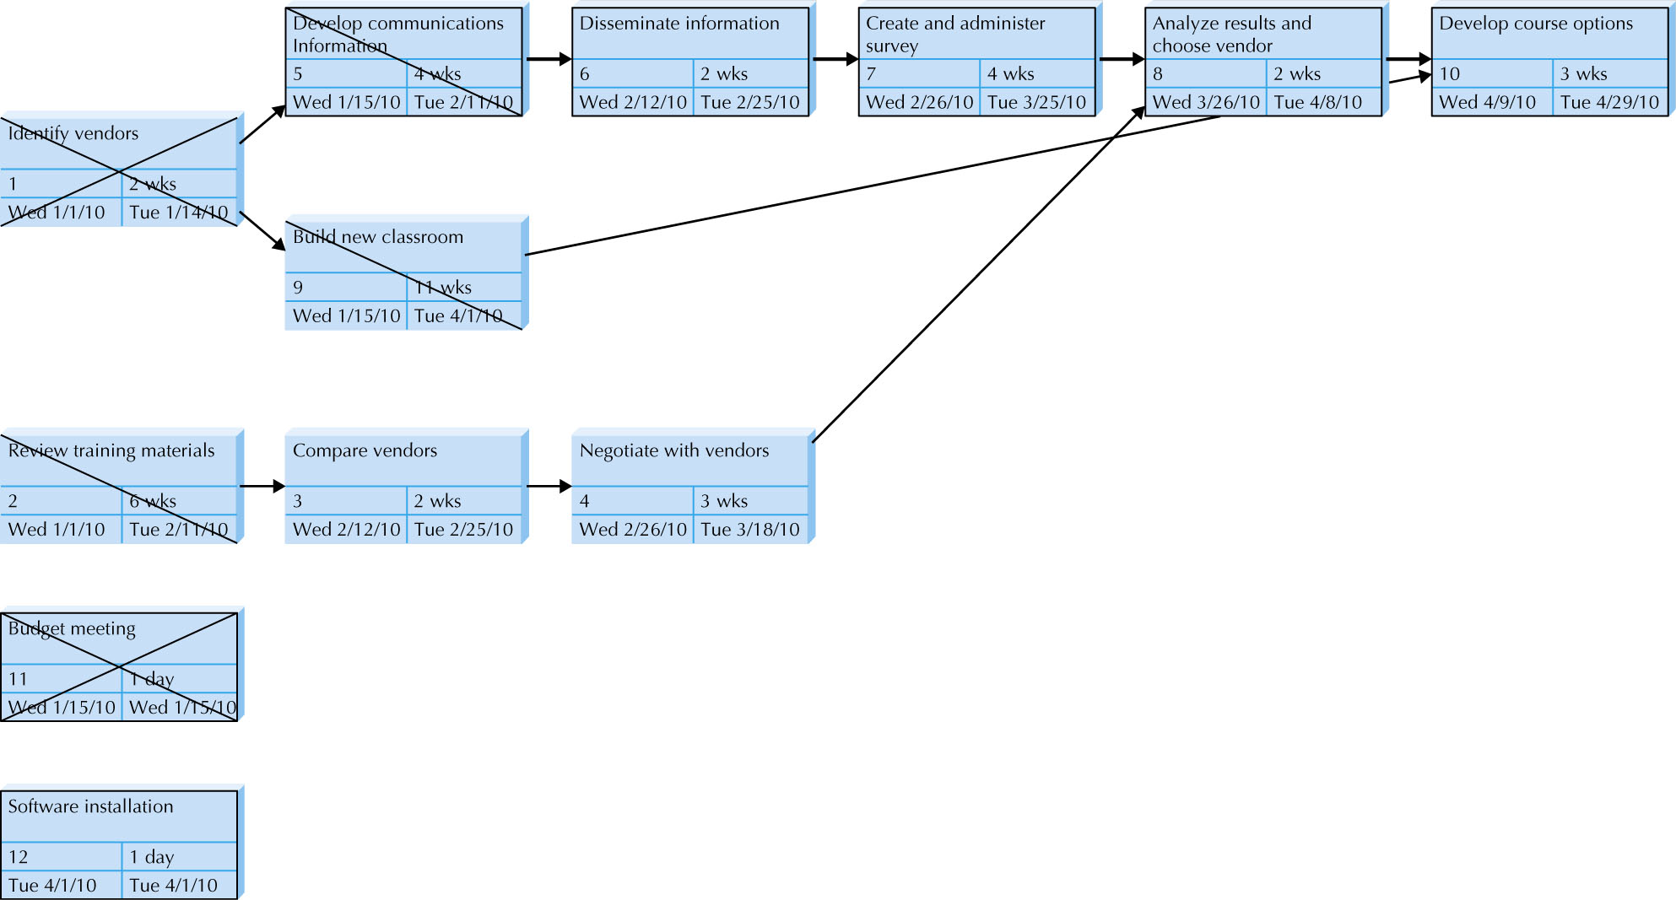
Tracking Tasks Using PERT Chart

Slide 44
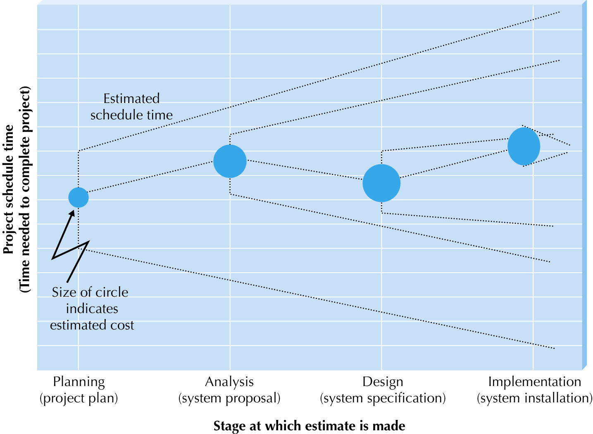
Refining Estimates : Hurricane Model

Slide 45
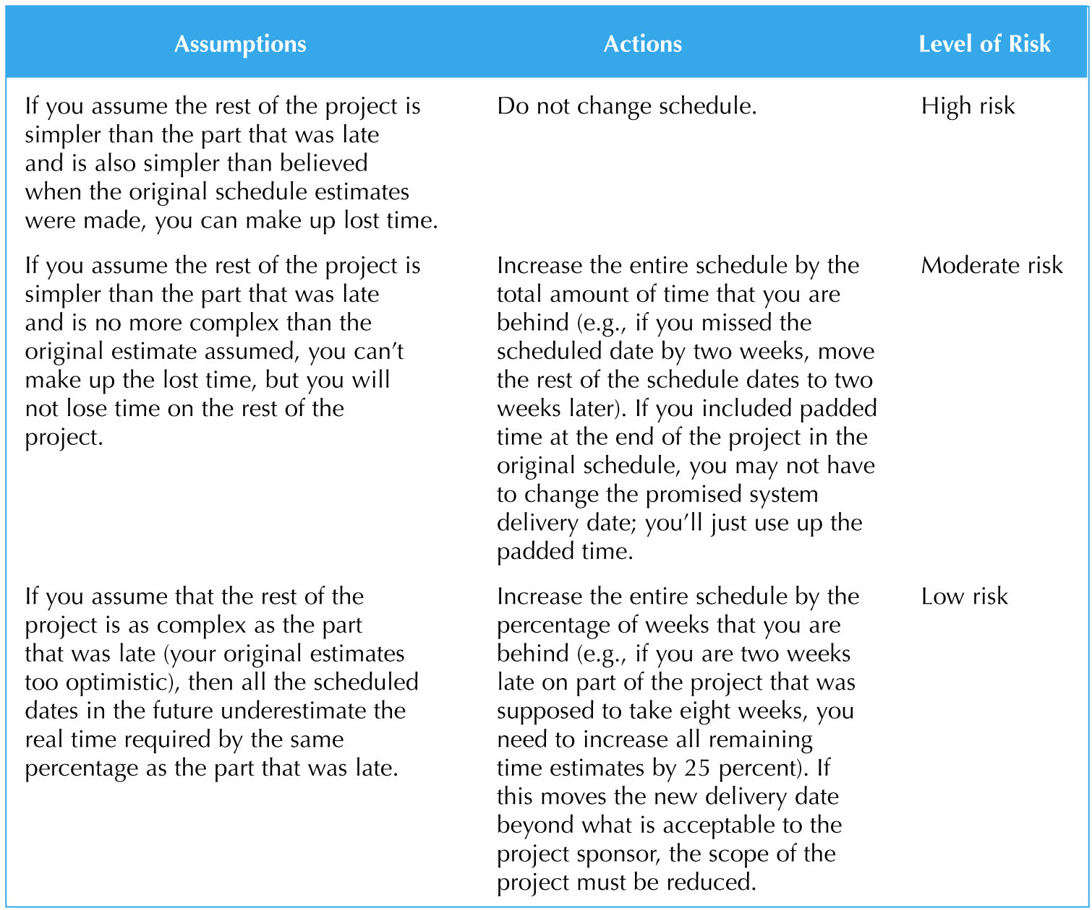
Possible Actions When Schedule Delayed

Slide 46
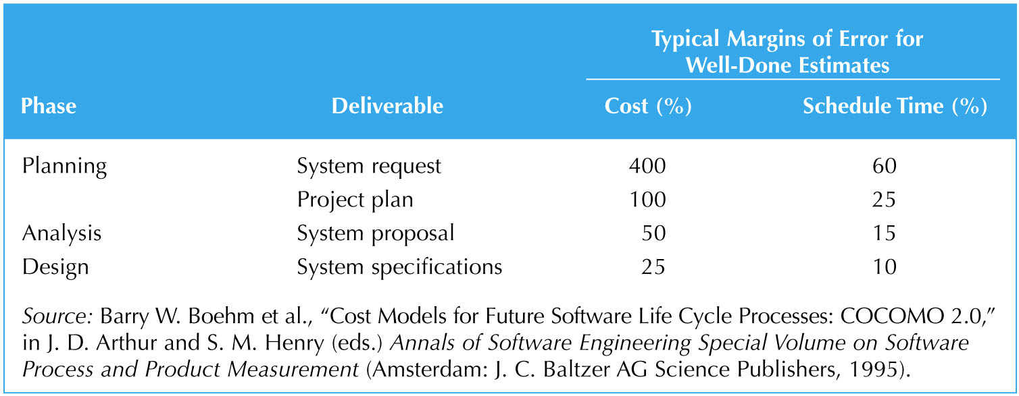
Managing Scope (1)
Scope creep
Schedule and cost overrun
Happens when new requirements are added
Margins of Error in Cost and Time Estimates

Slide 47
Managing Scope (2)
Scope management
RAD and prototyping
Formal change approval
Defer additional requirements as future system enhancements

Slide 48
Timeboxing
Fixed deadline
Reduced functionality, if necessary
Fewer “finishing touches”

Slide 49
Timeboxing Steps
Set delivery date
Deadline should not be impossible
Should be set by development group
Prioritize features by importance
Build the system core
Postpone unfinished functionality
Deliver the system with core functionality
Repeat steps 3-5 to add refinements and enhancements

Slide 50
STAFFING THE PROJECT

Slide 51
Staffing Attributes
Staffing levels will change over a project’s lifetime
Adding staff may add more overhead than additional labor
Using teams of 8-10 reporting in a hierarchical structure can reduce complexity

Slide 52
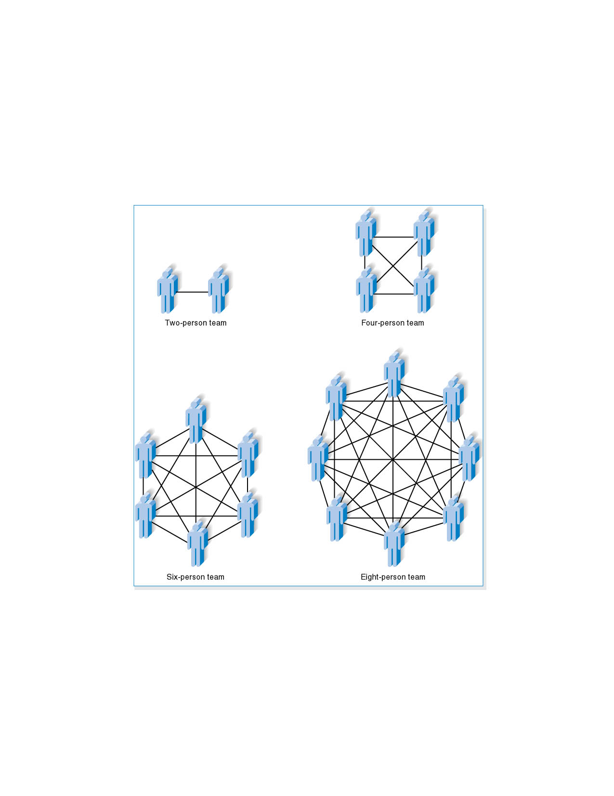
Increasing Complexity with Larger Teams

Slide 53
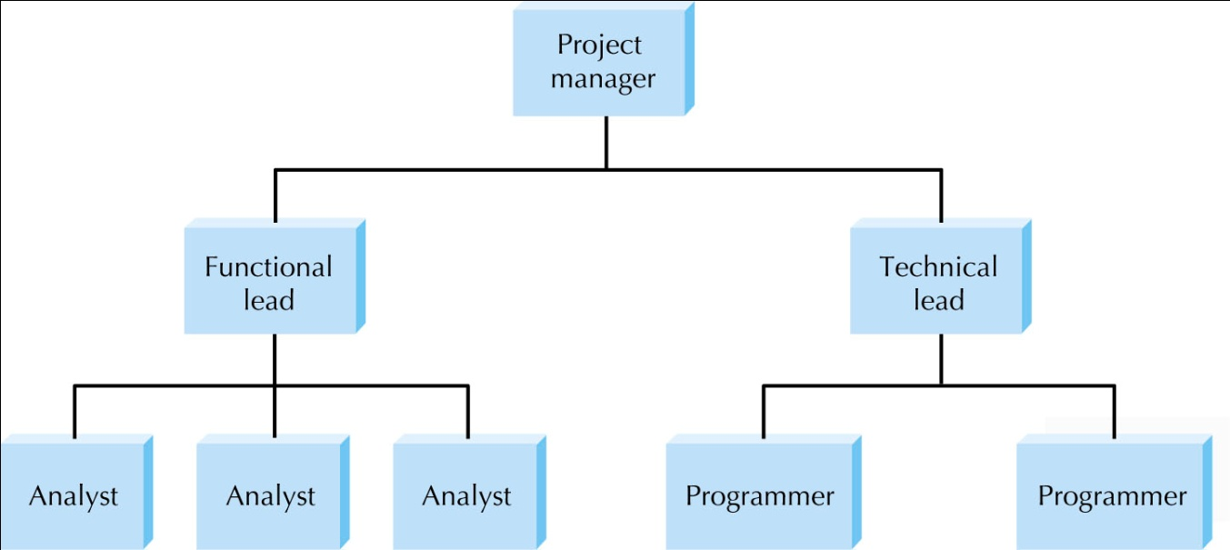
Key Definitions
The staffing plan describes the kinds of people working on the project
The project charter describes the project’s objectives and rules
A functional lead manages a group of analysts
A technical lead oversees progress of programmers and technical staff members

Slide 54
Motivation (1)
Motivation has been found to be the number-one influence on people’s performance
Use intrinsic rewards
Recognition
Achievement
The work itself
Responsibility
Advancement
Chance to learn new skills
Use monetary rewards cautiously

Slide 55
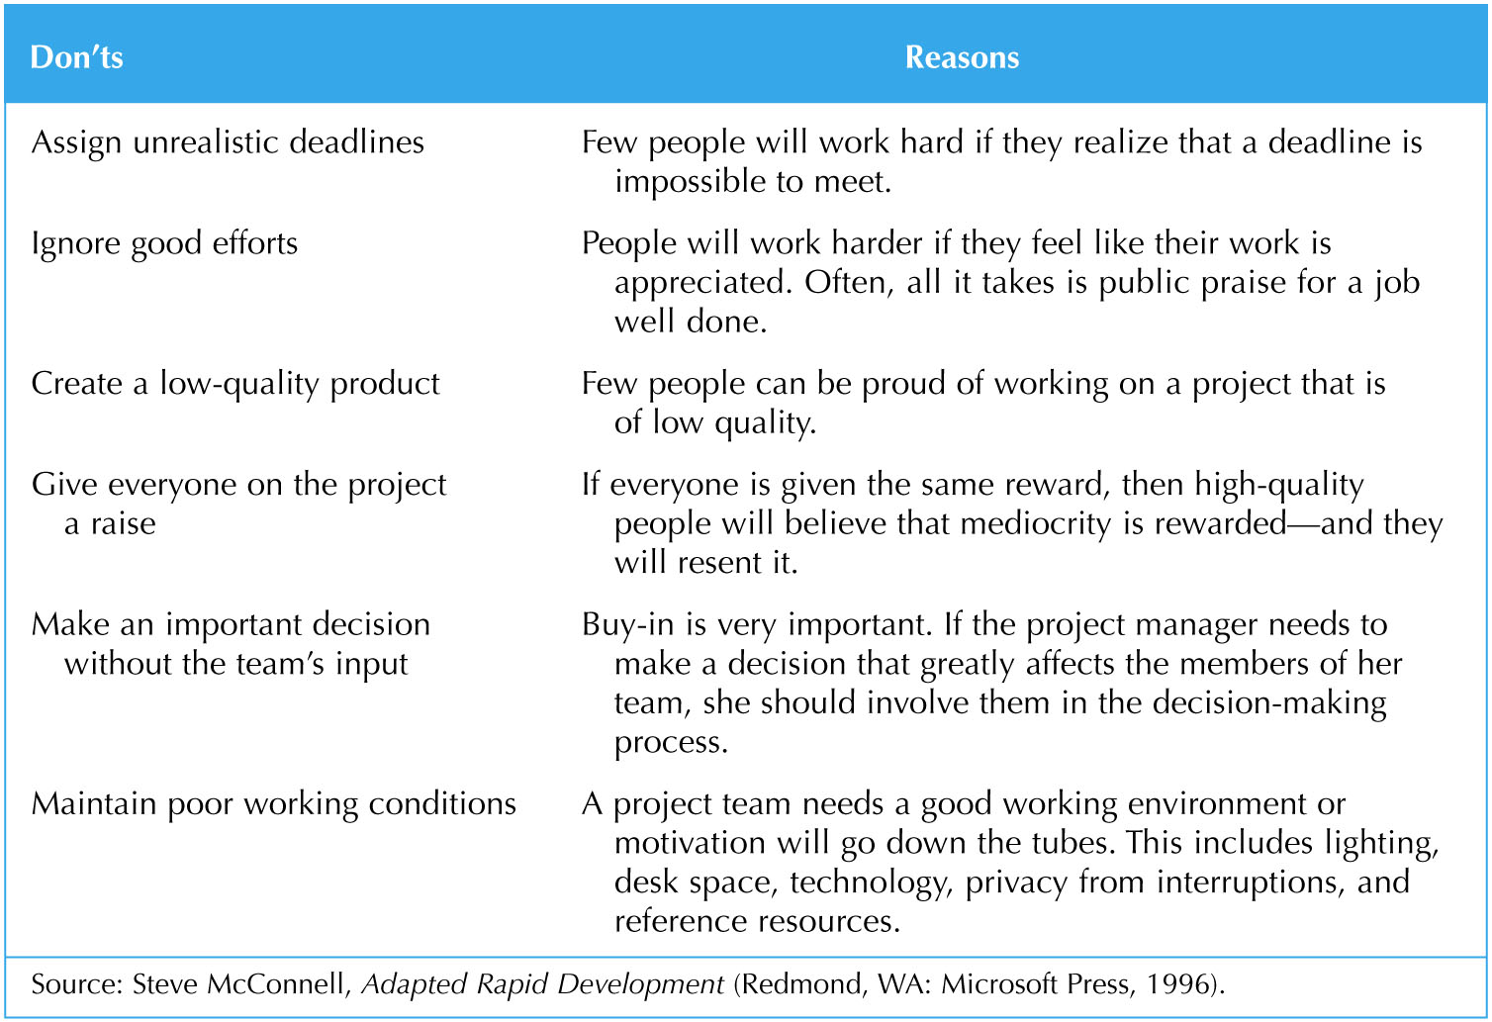
Motivation (2)

Slide 56
Handling Conflict
Clearly define project plans
Recognize project importance to organization
Develop detailed operating procedures and communicate these to the team members
Project charter listing norms and ground rules
Develop schedule commitments ahead of time
Forecast other priorities and their possible impact on the project

Slide 57
COORDINATING PROJECT ACTIVITIES

Slide 58
CASE Tools
Computer-aided software engineering (CASE)
Planning Analysis Design Implementation
Upper CASE Lower CASE
Integrated CASE (I-CASE)

Slide 59
Standards
Examples
Formal rules for naming files
Forms indicating goals reached
Programming guidelines
Documentation standards
Procedural standards
Specification Requirements standards
User interface design standards

Slide 60
Documentation
Project binder
Contain all the deliverables and all the internal communications
Continual updating

Slide 61
Managing Risk
Risk assessment
Weak personnel, scope creep, poor design, and overly optimistic estimates
Actions to reduce risk
Revised assessment

Slide 62
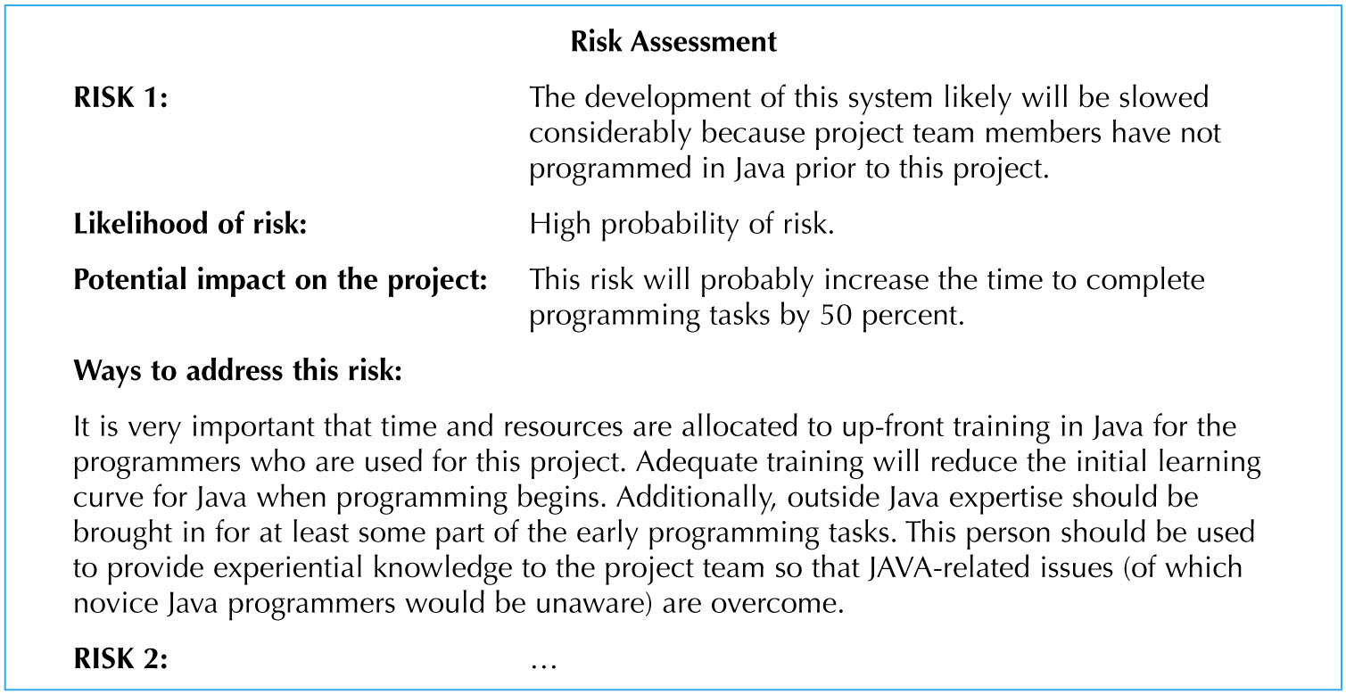
Example of Risk Assessment

Slide 63
Classic Mistakes
Overly optimistic schedule
Failing to monitor schedule
Failing to update schedule
Adding people to a late project

Slide 65
Creating & Managing the Workplan
Workplan: a dynamic and sequential list of all tasks needed to complete a project
Approaches:
Modify existing or completed projects
Derive the tasks from the methodology being used
Unified Process:
Iterative & incremental
Workplan is also iterative & incremental
Tasks and time intervals follow the phases
Different tasks executed for each workflow

Slide 66
Evolutionary Work Breakdown Structures
Organized in a standard manner across all projects
Created in an incremental & iterative manner
Generality supports learning from past mistakes and successes
Unified Process:
Workflows are the major divisions
Workflows are decomposed along the phases
Phases are decomposed along the required tasks
Tasks are added as each iteration is completed

Slide 67
Scope Management
Scope “creep”
Occurs after the project is underway
Results from adding new requirements to the project Can have a deleterious effect on the schedule
Techniques to manage the project scope:
Identify all requirements at the outset
Allow only those changes deemed absolutely necessary
Carefully examine the impact of suggested changes
Delay some changes for “future enhancements”
Time boxing
Notes:
Results from adding new requirements to the project
Can have a deleterious effect on the schedule(해롭다)
Identify all requirements at the outset(시초에)

Slide 68
Staffing the Project
Goals:
Determine how many people are required
Match skill sets to required activities
Motivate the team to meet the objectives
Minimize conflicts
Deliverable—The staffing plan, which includes:
Number & kind of people assigned
Overall reporting structure
The project charter (describes the project’s objectives and rules)

Slide 69
Creating a “Jelled” Team
A team of people so strongly knit that the whole is greater than the sum of its parts
Characteristics of a jelled team:
Very low turnover rate
Strong sense of identity
A feeling of eliteness
Team vs. individual ownership of the project
Team members enjoy their work

Slide 70
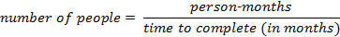
The Staffing Plan
Calculate the number of people needed:
Lines of communication increase exponentially as people are added to a project
Create a reporting structure for projects with large numbers of people assigned
Form sub-teams as necessary
Assign the Project Manager, Functional lead & Technical lead
Pay attention to technical and interpersonal skills

Slide 71
Motivating People
Motivation is the greatest influence on performance
Monetary rewards usually do not motivate
Suggested motivating techniques:
20% time rule
Peer-to-peer recognition awards
Team ownership (refer to the team as “we”)
Allow members to focus on what interests them
Utilize equitable compensation
Encourage group ownership
Provide for autonomy, but trust the team to deliver

Slide 72
Handling Conflict
Preventing or mitigating conflict:
Cohesiveness has the greatest effect
Clearly defining roles and holding team members accountable
Establish work & communications rules in the project charter
Additional techniques:
Clearly define plans for the project
Make sure the team understands the importance of the project
Develop detailed operating procedures
Develop a project charter
Develop a schedule of commitments in advance
Forecast other priorities and their impact on the project

Slide 73
Environment & Infrastructure Management
Environment—Choose the right set of tools
Use appropriate CASE tools to:
Increase productivity and centralize information (repository)
Utilize diagrams—more easily understood
Establish standards to reduce complexity
Infrastructure—Document the project appropriately
Store deliverables & communications in a project binder
Use Unified Process standard documents
Don’t put off documentation to the last minute

Slide 74
Summary
Project management is critical to successful development of new systems
Project management involves planning, controlling and reporting on time, labor, and costs.

Slide 75
Summary
Project Initiation
Feasibility Analysis
Project Selection
Traditional Project Management Tools
Estimating Project Effort
Create and manage the workplan
Staff the project
Manage the environment and infrastructure work flows of the project

